Slide 1

Field Crop Production Analysis
Mohammed Akram Akbar
Dilip Pinnamreddy
Saksham Rana
Srikanth Tammina
Ananthu Vijay

Slide 2
Objective
Our dashboards are intended for federal agencies who oversee food security. These help officials track production of key crops, and prepare for possible low/high yields and position policies to either grow or abate the crops for favorable outcomes.
These dashboards could also help crop based manufacturing businesses to locate close to the supply locations.
Notes:
Ex for the first point here could be
How federal government in the past have seen a growing demand for corn and provided incentives to farmers to grow more of it making U.S. currently the largest exporter. Similarly, the federal government has not provided incentives to oats for last several years now. Oats which was one of the staple food sources and heavily produced crop in the U.S. has seen a steady decline.
Ex for the second point here could be
Ethanol industry which has successfully identified high growing states across the U.S. and positioned themselves nearby supply, which enabled them to grow at a faster rate over the last few years. Similarly, new industries similar to exiting industries like Quaker Oats or some company that could create a new product altogether from a crop like Sorghum Syrup could position themselves better. Not only new industries, but current growing industries like ethanol can position themself better with these visualizations

Slide 3
Data Description
Data Categories
Production across U.S. counties
Acres planted across US states
Acres harvested across U.S. states
Yield per acre of the crop produced
Characteristics
21k fields x 881k rows
Data spanning from 1950-2021
Data sourced from United States Department of Agriculture
National Agricultural Statistics Service
Crops considered
Barley
Corn
Oats
Rice
Sorghum
Soybeans
Wheat

Slide 4
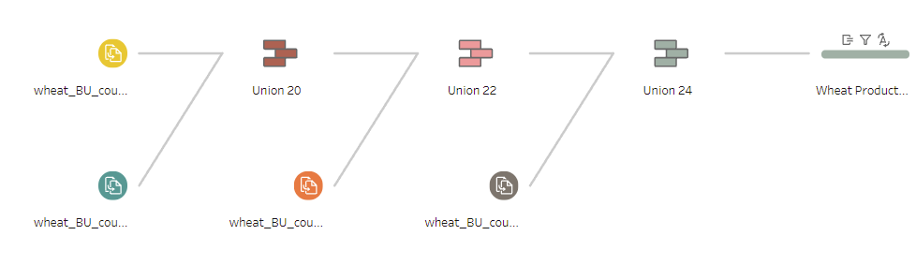
Data Preprocessing - I
Due to the limitation of exporting 50,000 rows at a time, we had to export the data in batches for each crop.
Converted the Value field into Numeric.
Removed Null Values from the Numeric Value field.
Created a Calculated field Value in Metric Tons.

Slide 5
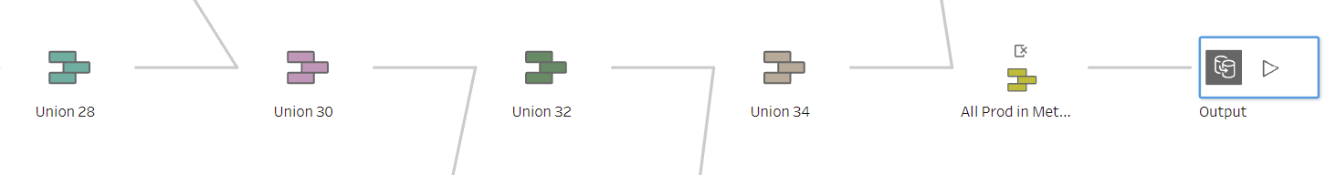
Data Preprocessing - II
After performing a union for each crops, we combined all crops in a segment together, again using union
In the final clean step,
Removed unused columns created during unions.
Removed unused columns from the original data source.
Changed the role and type of state.

Slide 6
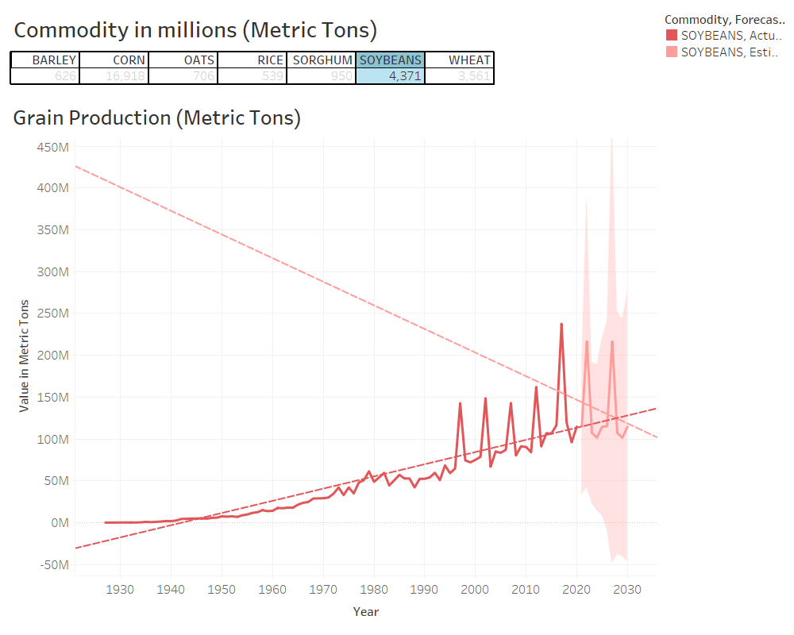
Soybeans Production
Trends
Production data over time to understand trends
Forecast
Use past trends to create regression based predictions

Slide 7
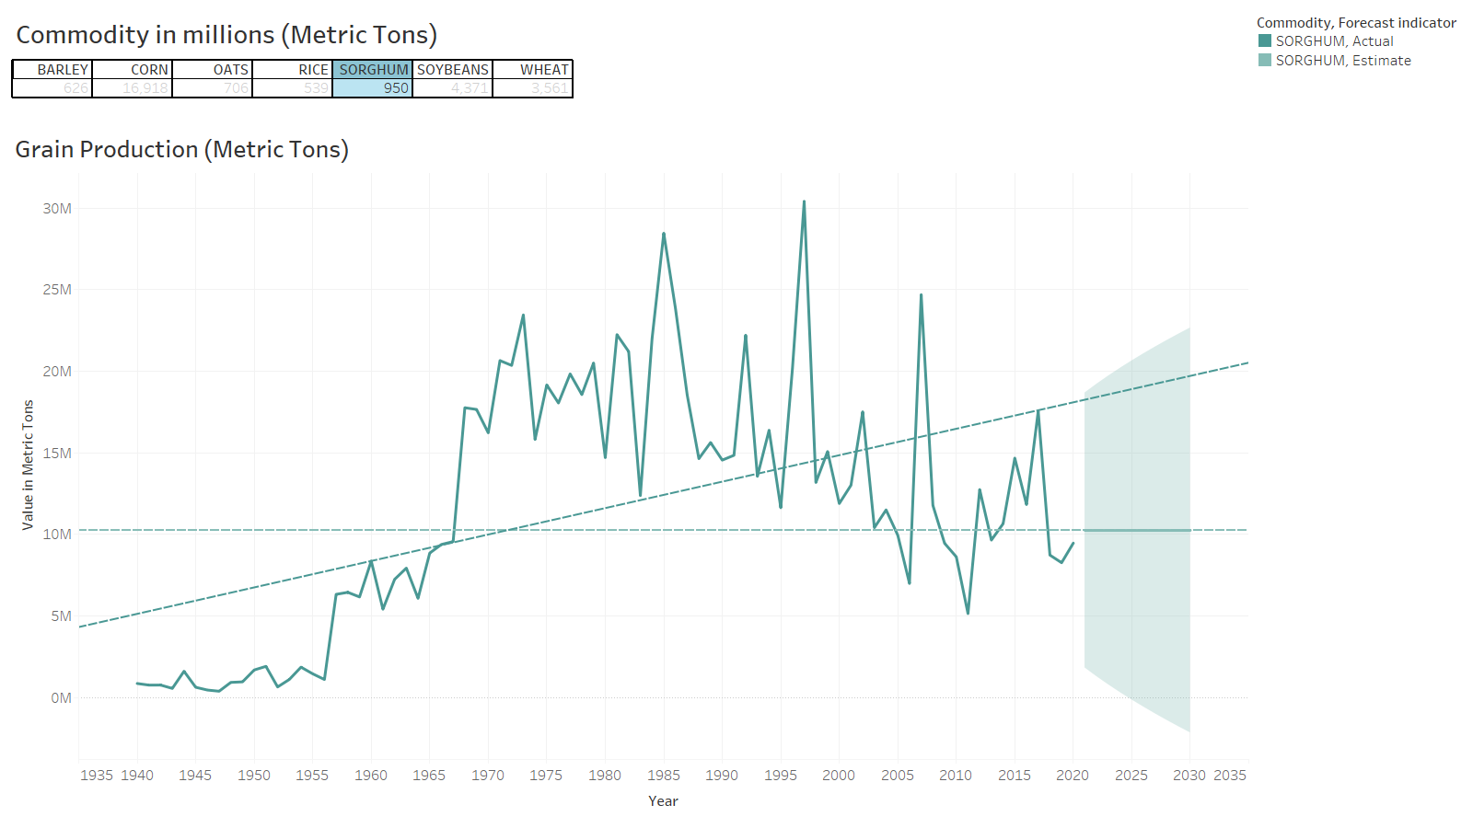
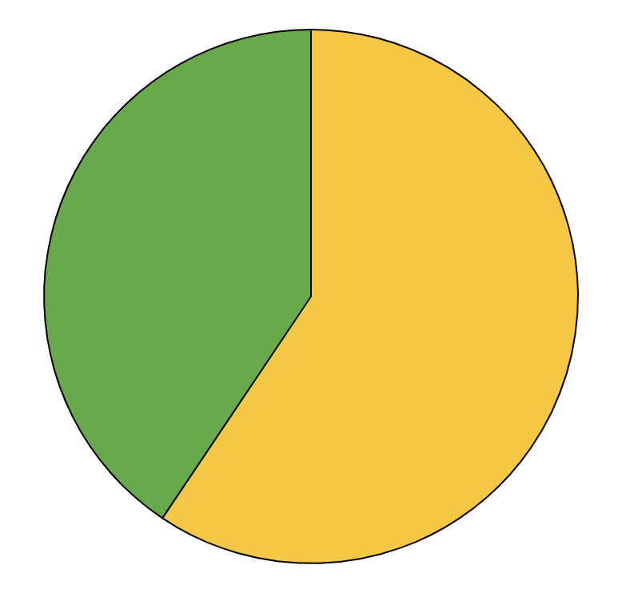
Sorghum Production
Trends
40%
Production data over time to understand trends
Forecast
60%
Use past trends to create regression based predictions
Follow the link in the graph to modify its data and then paste the new one here. For more info, click here

Slide 8
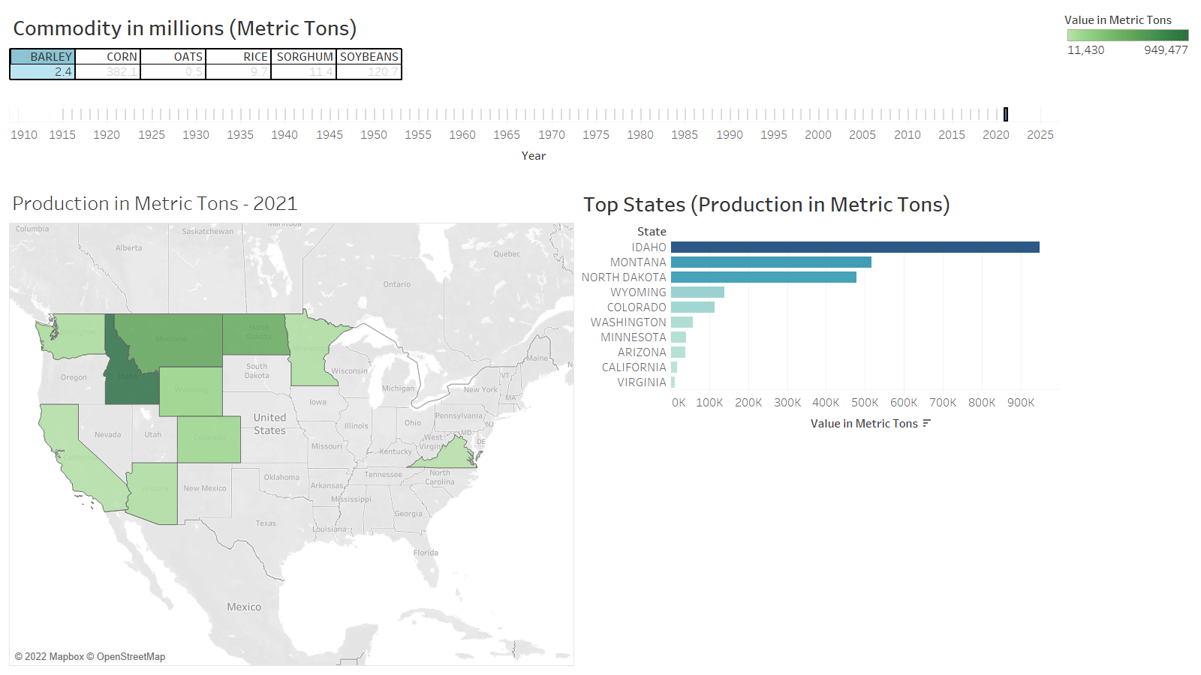
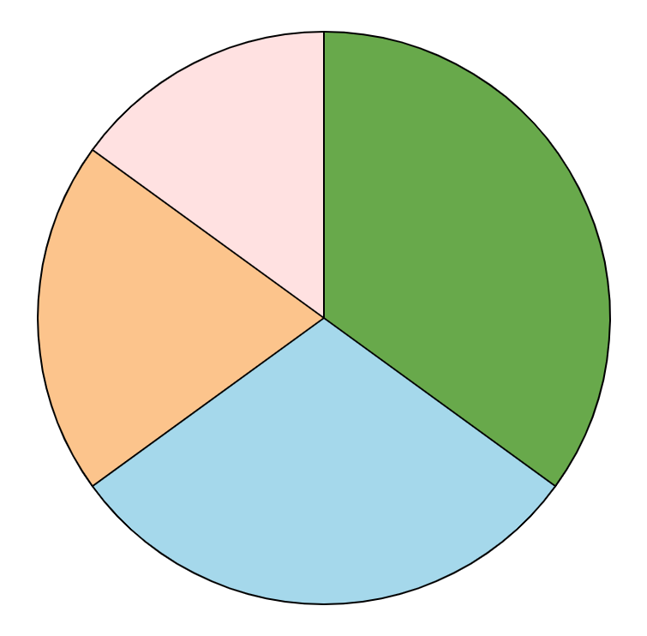
Investment
Employees
Machinery
Neptune is far away from Earth
15%
Venus has a beautiful name
35%
20%
Structure
Technology
Mercury is the smallest planet
Saturn is a gas giant with rings
30%
Barley production across multiple states in USA
Follow the link in the graph to modify its data and then paste the new one here. For more info, click here

Slide 9
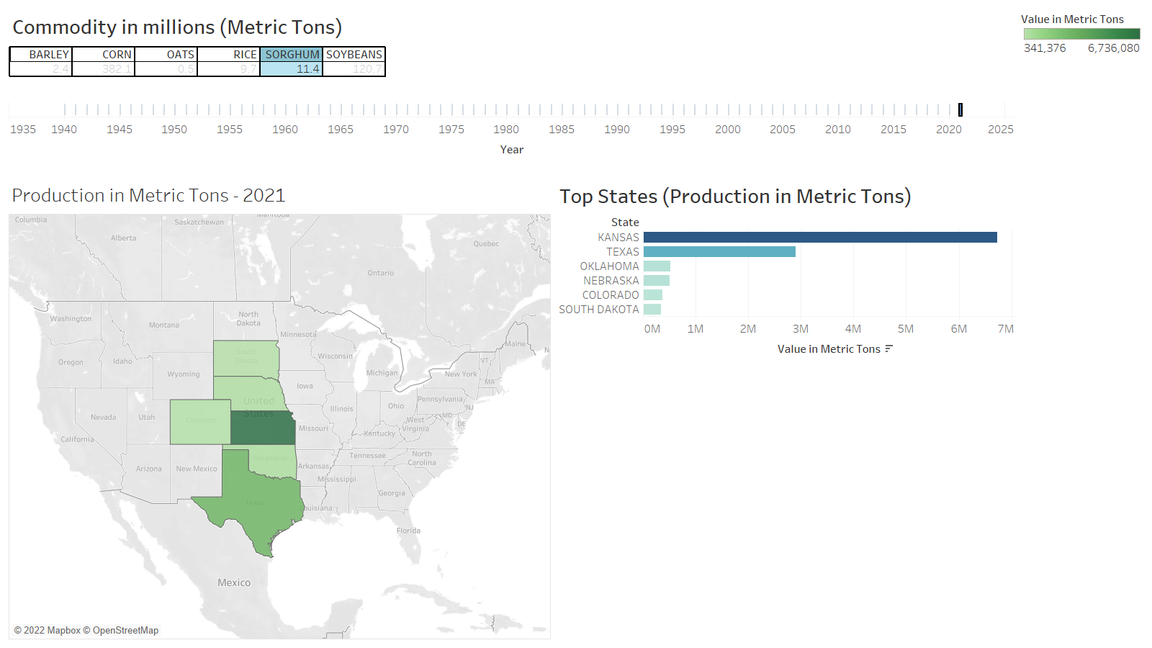
Investment
Employees
Machinery
Neptune is far away from Earth
15%
Venus has a beautiful name
35%
20%
Structure
Technology
Mercury is the smallest planet
Saturn is a gas giant with rings
30%
Sorghum production across states in USA
Follow the link in the graph to modify its data and then paste the new one here. For more info, click here

Slide 10
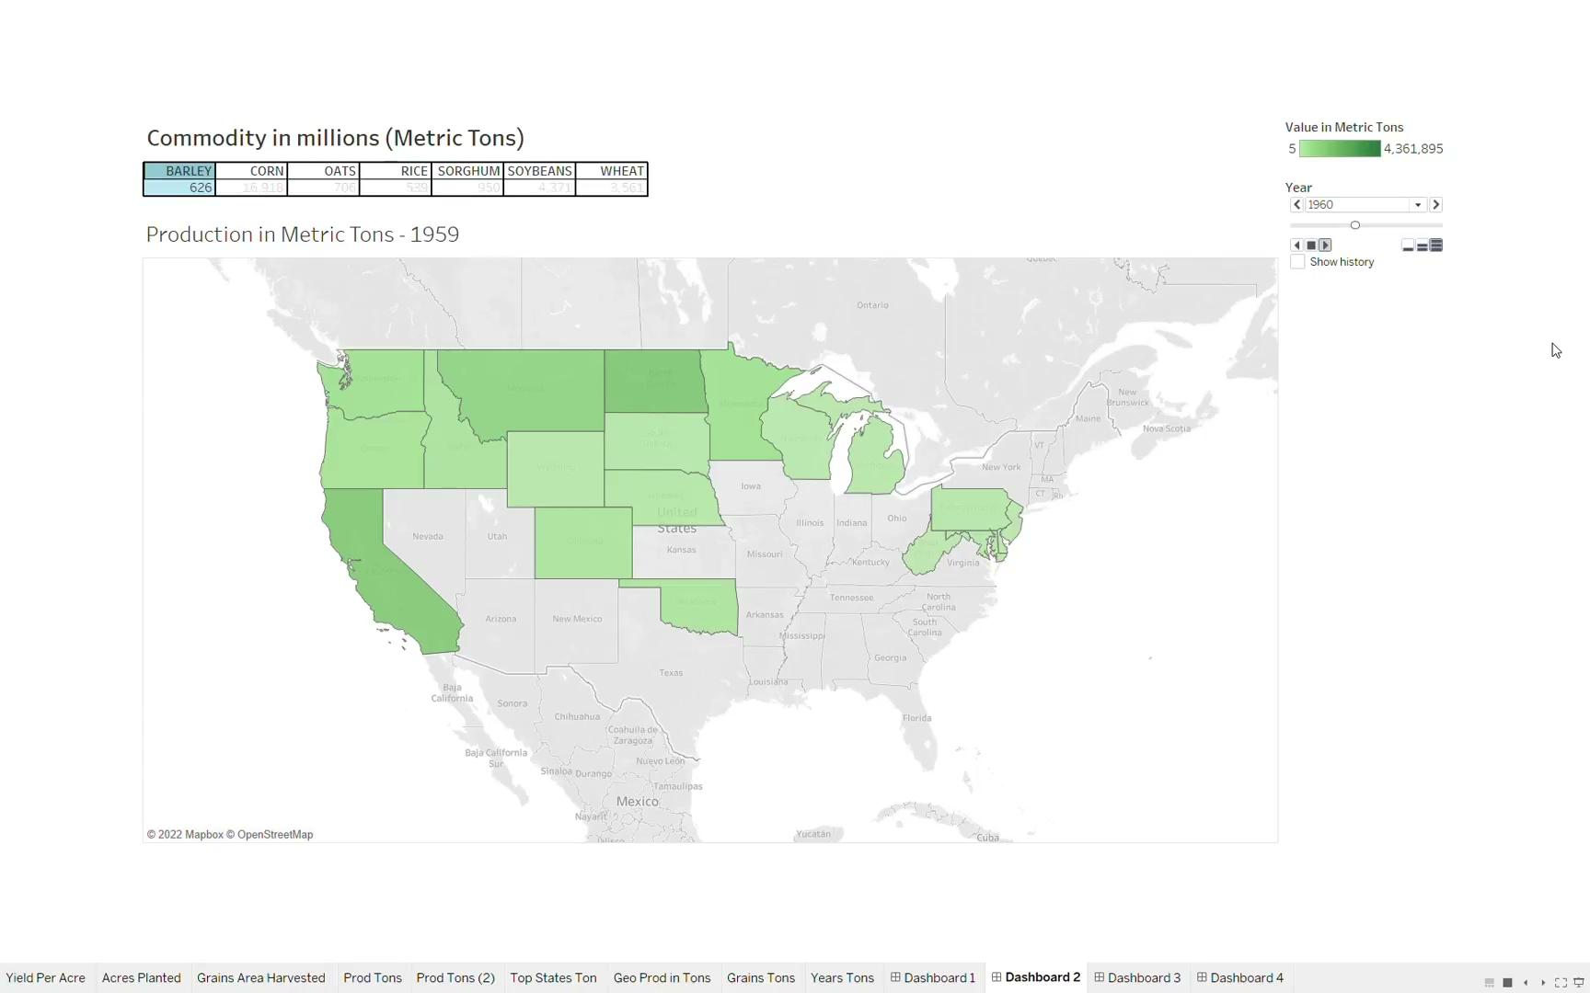

Slide 11
Leaders in production
BARLEY
Idaho
Montana
North Dakota
RICE
Arkansas
California
Louisiana
OATS
Minnesota
Iowa
North Dakota
CORN
Iowa
Illinois
Nebraska
SORGHUM
Kansas
Texas
Oklahoma
SOYBEANS
Illinois
Iowa
Minnesota
WHEAT
Kansas
North Dakota
Washington

Slide 12
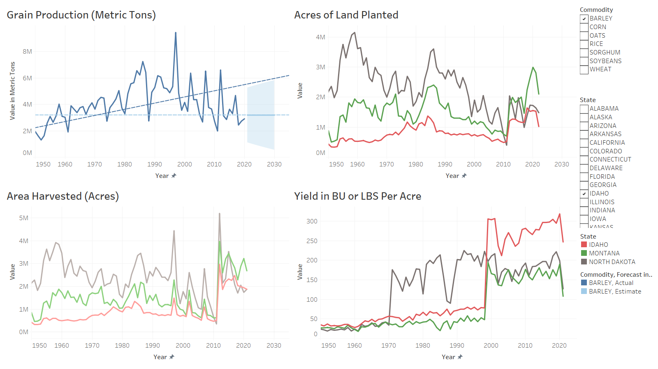
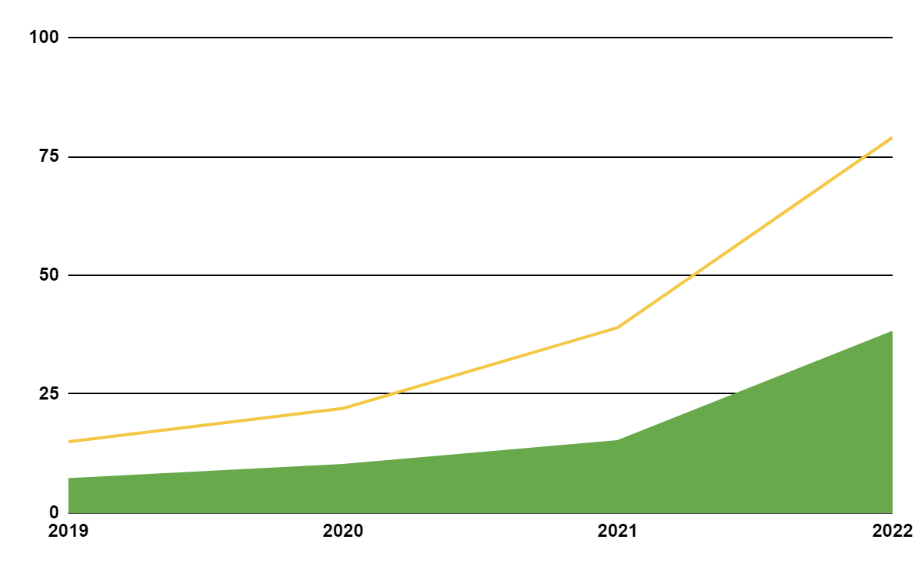
Deep Dive
Track Crop Yield
Barley
Compare with key metrics

Slide 13
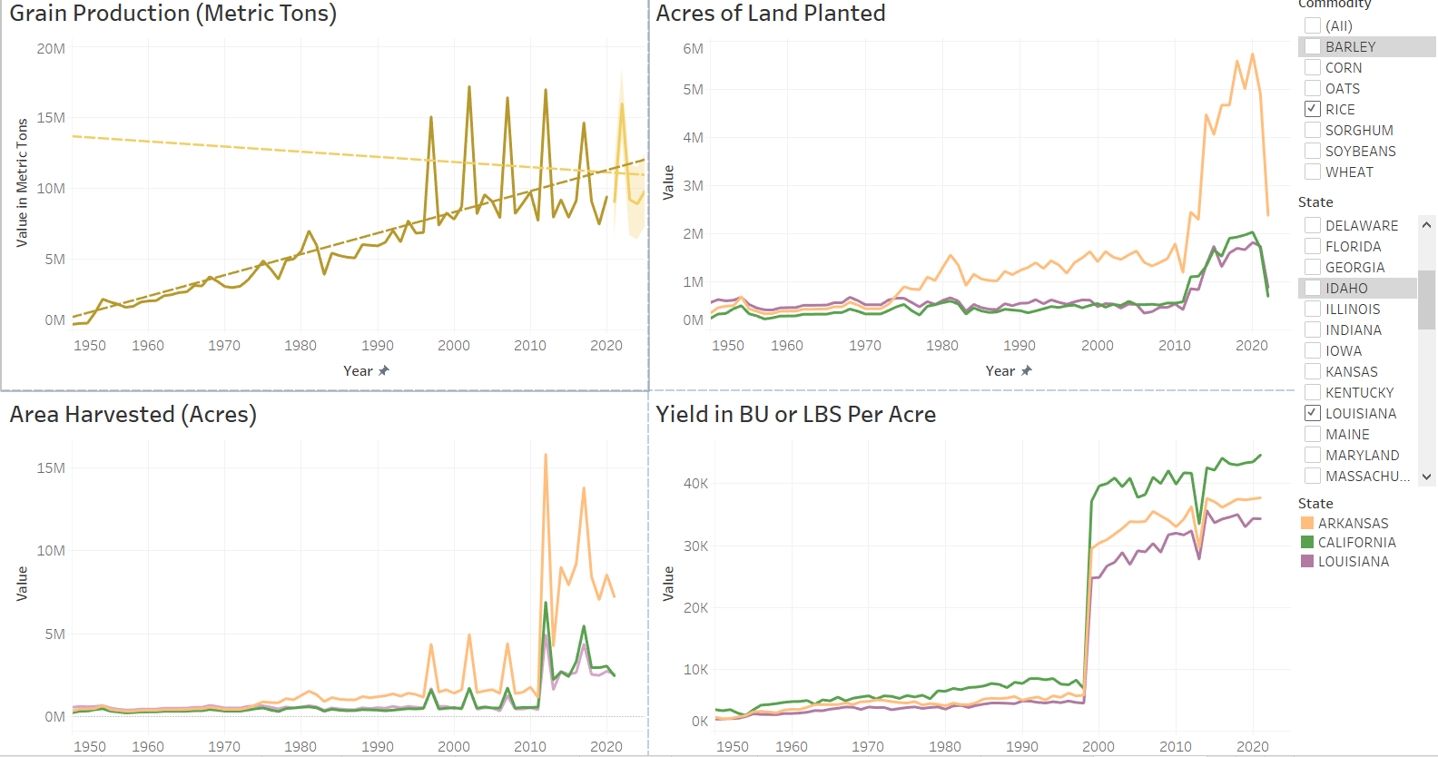
Deep Dive
Track Crop Yield
Rice
Compare with key metrics

Slide 14

Future Improvements
01
Merge with usage data
02
Optimization
03
Market & competition
04
Future Ready
Extract insights on state demand & wastage
Optimize production & inventory
Position industries better for more profits
Forecasting yield & usage helps in contingencies
Notes:
2. And thus reduce the business expenditure on it.
3. Once we better understand the market and competition, we are in a better position to estimate industries for more profits
4.

Slide 15

Thank you
Questions?

